Slide 1
Bring the fun back to HS STEM assessment
April McKnight
Secondary STEAM educator
@rilmcknight
www.rilmcknight.com

Slide 2
The primary purpose of assessment and evaluation is to improve student learning

Slide 3
What are:
Assessment for learning
Assessment as Learning
Assessment of Learning
?

Slide 4
Assessment for Learning
The ongoing process of gathering and interpreting evidence about student learning for the purpose of determining where students are in their learning, where they need to go, and how best to get there

Slide 5
Assessment as Learning
The process of developing and supporting student metacognition. Students are actively engaged in the assessment process; that is, they monitor their own learning

Slide 6
Assessment of Learning
The process of collecting and interpreting evidence for the purpose of summarizing learning at a given point in time, to make judgements about the quality of student learning on the basis of established criteria, and to assign a value to represent that quality.

Slide 8
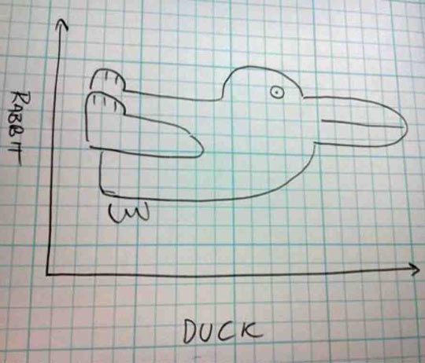

Slide 9
Task 1
How long does it take for a candy to dissolve?
Work with a buddy to figure this out?

Slide 10
Task 2
How do you assess the learning here?
Lab write up …..
Questions answered…..
For me it’s the process of doing the experimenting

Slide 11
Project Based Learning
is a teaching method in which students gain knowledge and skills by working for an extended period of time to investigate and respond to an authentic, engaging, and complex question, problem, or challenge.
requires critical thinking, problem solving, collaboration, and various forms of communication.
students need to do much more than remember information.
need to use higher-order thinking skills and learn to work as a team.

Slide 12
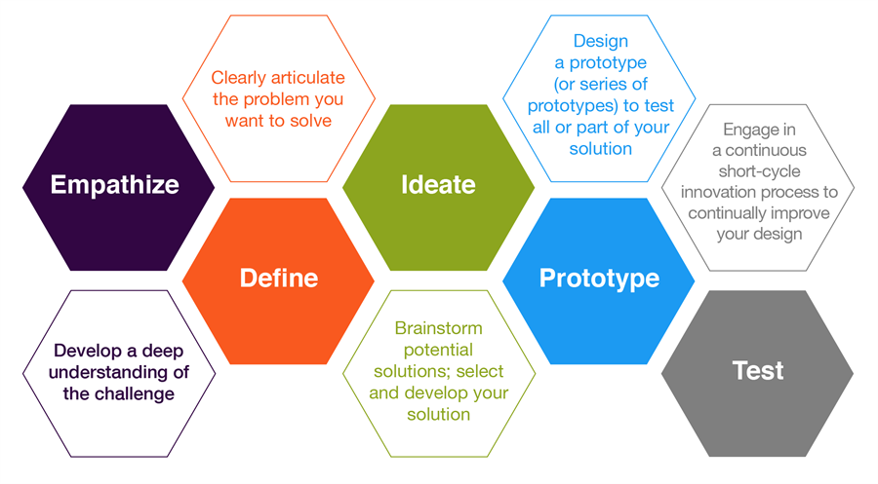

Slide 13
Ideate
Brainstorm ideas where nothing is a bad idea even if its extremely weird or unbelievable
What other use could you have for a Bandaid?

Slide 14
Performance Tasks for Chemistry
Mr Mole Business Proposal
Gas Laws Presentation
Crystal Exhibit
Particle Comic Strip
Ester Bath Bomb

Slide 15
Business Proposal to Mr. Mole
Your task:
Come up with a product and a business model that can be expressed as an equation. The components of your product are the reactants and your product is what is produced when all reactants combine in the appropriate ratios. At least one of the components in your equation must be a number other than one. Be sure to include profits and expenses in your equation.
Your detailed business proposal must include:
A persuasive cover outlining your product and business model
Supporting argument(s) to convince Mr. mole to finance your proposal
A business equation describing all reactants and products
Supporting data tables (include potential profits and expenses)
Sample calculations of formulas used in the data table
Business ideas for your proposal:
Manufacturing of a product
Cooking/ food service
Agriculture
Mining
Other (Your choice)

Slide 16
Checklist
Unique or novel product is presented in the cover letter using effective persuasive language
Supporting arguments in the cover letter make sense and are highly influential
Business equation is present and clearly outlines all the variables present in the cover letter
A business equation with ratios more complex than 1:1 is present and all variables are present in the cover letter
Supporting data table contains all variables stated in the equation
Business proposal is concise, organized so it is easy to read, and word processed

Slide 17
Main themes | main question | final project
Atoms and bonding | Chemical composition of compounds and naming
Chemical reactions and law of conservation of matter | Everything as a reactant can be found as a product
Mole unit and conversion | Balancing equations and composition
Stoichiometry ratios | Keeping ratios consistent throughout increases and decreases

Slide 18
Main themes | main question | final project

Slide 19
Performance Tasks for Math
Sequences and Series Art Project
Drawing/Art – Create a visual representation of a sequence/series. Sketch out rough drafts to make sure you’re on the right track. Once you are ready, take your time in creating a final product that incorporates color and creativity. While I do not expect all of you to be supreme artists, your product will be graded on accuracy and execution. Please create a product that you are proud of and will enjoy showing the class.

Slide 20
Performance Based Exams
Performance based testing is a form of testing that requires students to perform a task rather than an answer from an already made list.
Hands on Lab finals in all classes of high school STEM

Slide 21
Station 1
Procedure:
1. Find the mass of your piece of chalk
2. In the parking lot write your name on the ground with letters at least 30 cm high
3. Find the mass of your chalk after writing your name
Calculations:
1. Determine the mass of chalk used to write your name on the ground.
2. Determine the molar mass of chalk.
3. Determine the number of moles used to write your name.

Slide 22
